Slide 1


Slide 2

Who am I?
David Lee (Epidemic 4.3#3453)
IT Major
Competitions
HiveStorm ‘21
CCDC ‘21
Conferences
Defcon ‘20-’21
Got a lot to learn

Slide 3

Agenda
Club Description
Convention: CactusCon
Questions?
Lab
https://cyberdefenders.org/

Slide 4

What is Cybersecurity Devils?
An environment where students learn hands-on defensive cyber security skills
Compete in cybersecurity competitions
Future workshops will be in-person @ Poly campus Library
TBA
Meeting are ~1-2 hours

Slide 5


What can Cybersecurity Devils do for YOU
Build real skills with real tools
Connect with likeminded cybersecurity enthusiasts
Give your resume some flavor

Slide 6

Convention: CactusCon
Local? Free? Why not both?
February 4-5, 2022
Mesa, AZ
Schedule out now (#resources)
Incident response
Malware detection/ analysis
Cloud computing
Covert communications
Cryptography
Network recon
Framework vulnerabilities
Mobile security
Social engineering

Slide 7

Questions?

Slide 8

Lab @ https://cyberdefenders.org/
Win/Lin/Mac
Install Wireshark
Create free account @ https://cyberdefenders.org/
Under ‘Practice’ tab, Search ‘HoneyBOT’
Questions 1-5
https://cyberdefenders.org/blueteam-ctf-challenges/45
Look for the Story
How does blank data fit into the bigger picture?

Slide 9

What is Wireshark?
Free and open-source packet analyzer
Easy to introduce, difficult to master
features to note in this lab
Statistics tab -> Conversations
Helps organize the noise

Slide 10

CVE
Common Vulneraries and Exposures
https://www.exploit-db.com/
https://cve.mitre.org
https://nvd.nist.gov/
Often easier to google aspects of potential CVE than searching each sites database

Slide 11
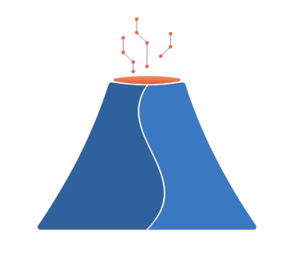
Brim
For our purposes
Like Wireshark, but explores protocols like SOCKS more

